Slide 1
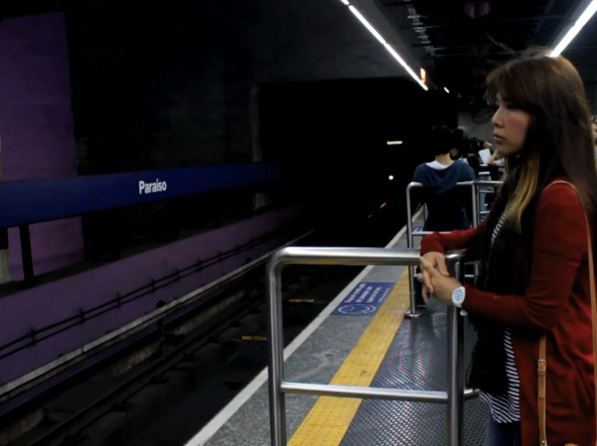


Slide 2

Seeing what’s happening right now, anywhere around the world.

Slide 3


Slide 4







Slide 5


182 M
Smartphone users watching videos monthly in US ALONE
300hrs/min
of uploaded videos

Slide 6



Record Video

Slide 7
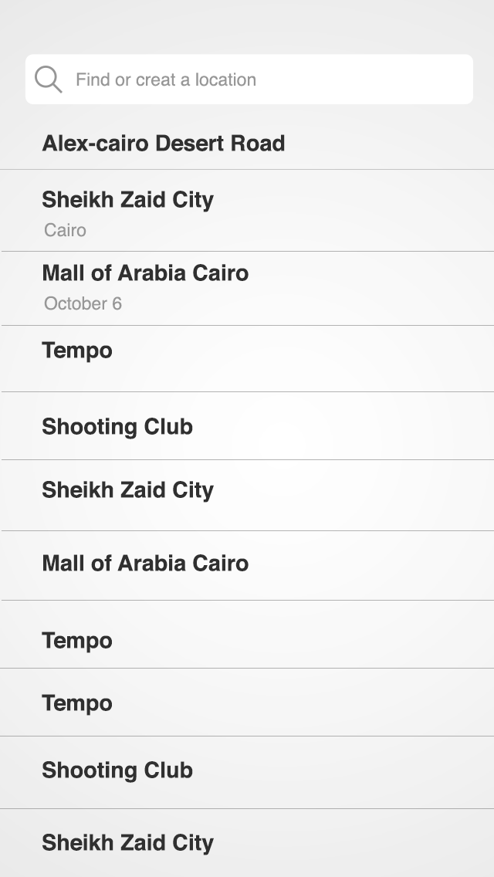
Add Location

Slide 8

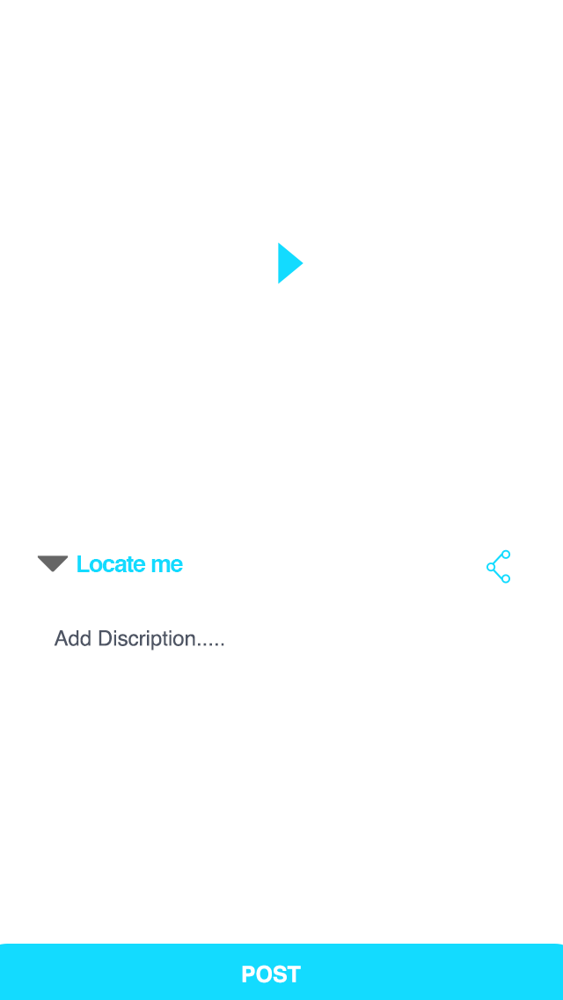
Describe &
Hashtag it!

Slide 9
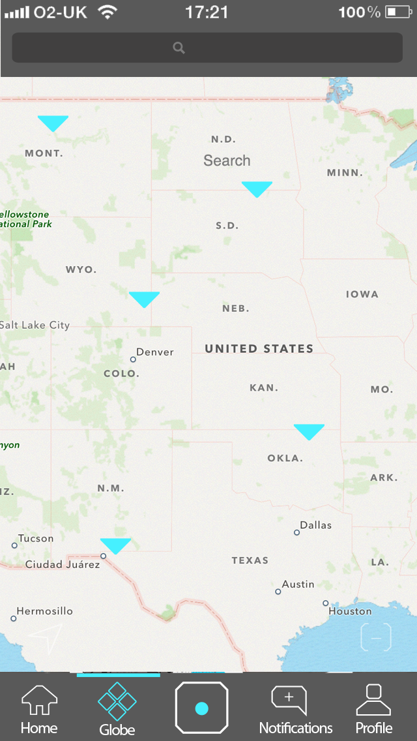
Search Everywhere
Globe View
Public Shares

